Slide 1
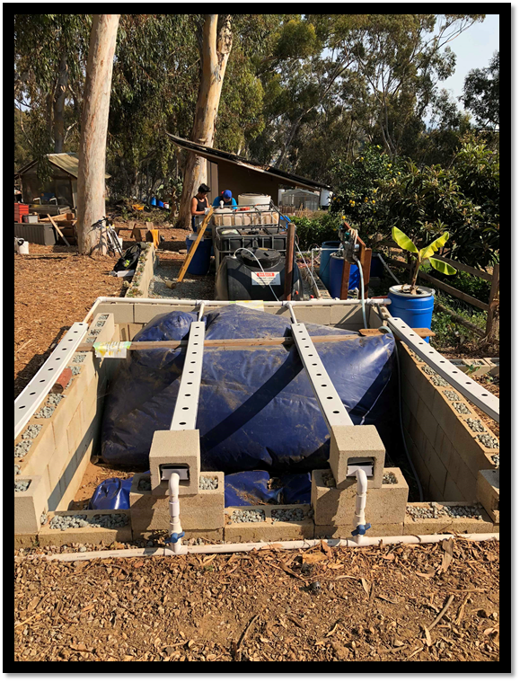
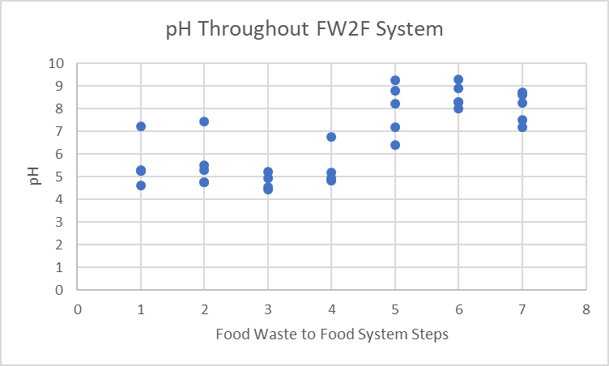
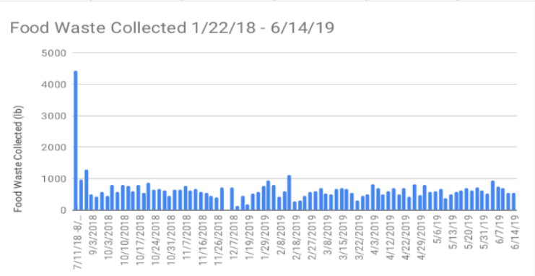
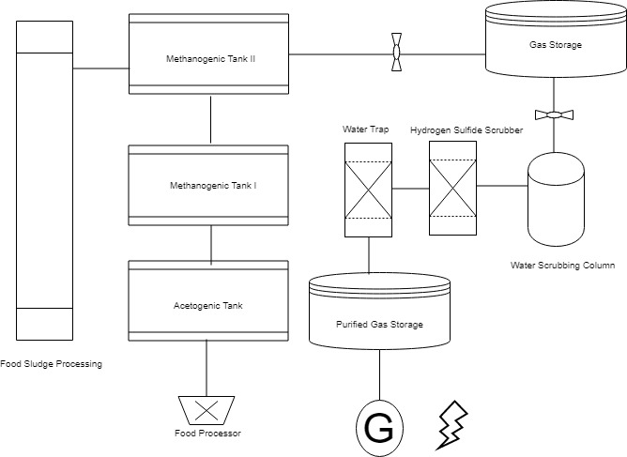
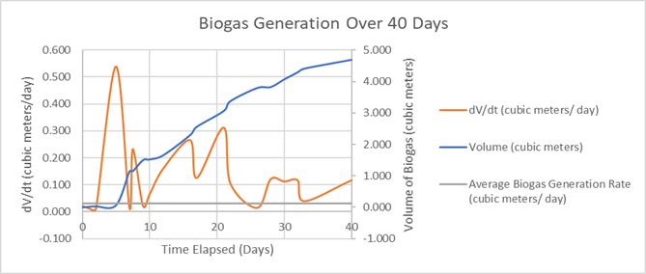
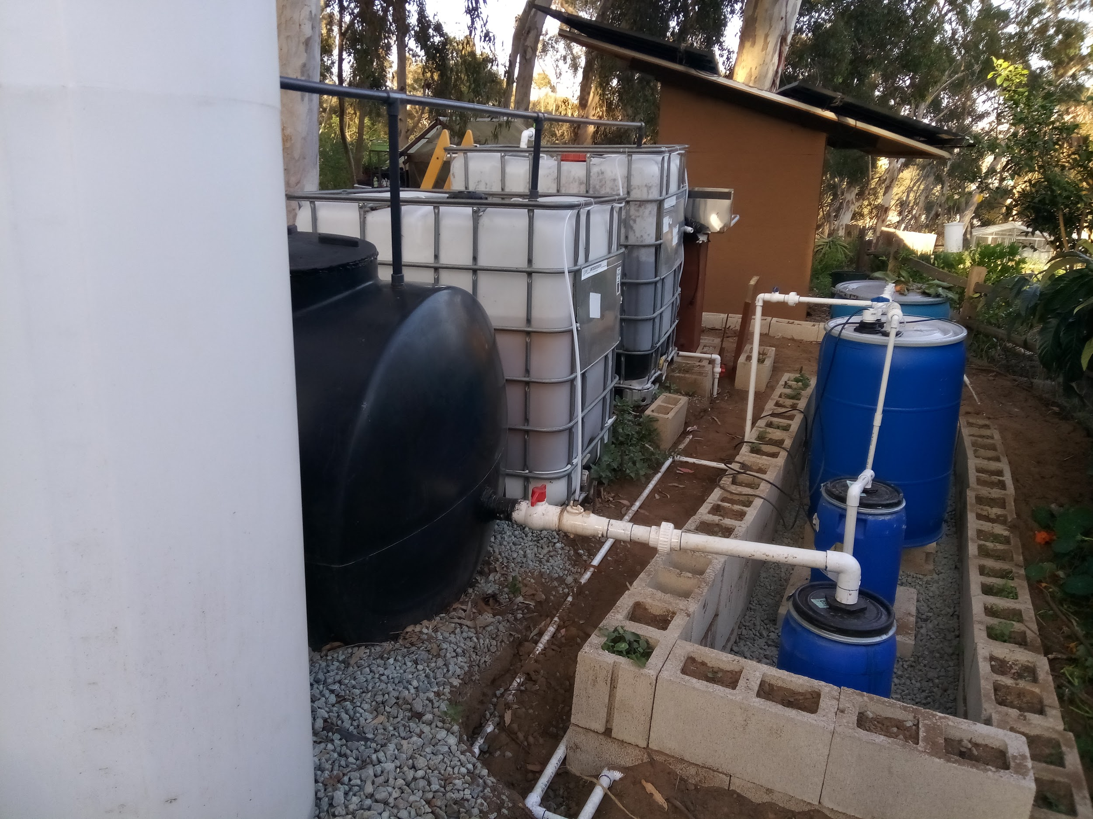
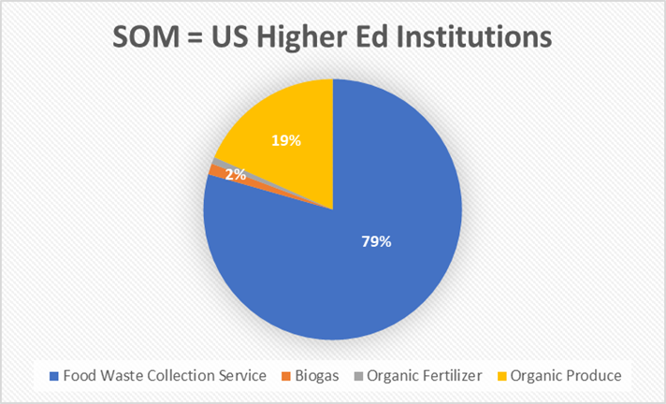
The BioEnergy Project Enid Partika
Introduction
Results
Conclusions
Anaerobic digestion technology uses the metabolism of anaerobic bacteria to convert food waste into methane, carbon dioxide, and other trace gases, in addition to sludge byproduct that can be converted into fertilizer. While anaerobic digestion has been a technology used for many centuries, it has not yet been taken to the 21st century in terms of use in the modern urban small-scale setting. This project aims to tackle the trilemma of overfilling landfills, climate change, and increasing energy and food demand by using anaerobic digestion to convert food waste from local restaurant vendors into organic produce via hydroponics and biogas for heat, cooking, and electricity.
Successful establishment of student positions to pick up food waste
In one year, 59,000 lbs. of food waste was collected, equating to 4 MTCO2eq.
Maintaining 7.2 – 7.6 pH with natural products enables successful plant growth
Consistent feeding and semi-frequent inoculation generates biogas
Biogas generation rate spikes after each consistent feeding
Significant market potential, especially in food waste collection and repurposing
Localized self-sufficient food and energy source that is carbon neutral
Project Goals
Digestate had to be diluted to a Total Dissolved Solids of 800ppm and kept at a Dissolved Oxygen greater than 6 ppm to be used as fertilizer. The best plants grown were found to be leafy greens and brassica compatible with the NPK Ratio 8-0-2, at a pH between 7.2 - 7.6.
Establish permanent food waste collection system within university
Improve System Efficiency by controlling Environmental Factors
Grow food with fertilizer from digestate
Achieve biogas generation and generation rate
Analyze the anaerobic digestion market availability
pH and DO both had positive correlation to the aeration of digestate in our processing system, which allowed for sufficient fertilizer production of 50 gallons per day maximum. In one year, 59,000 lbs. of food waste was collected, equating to 4 MTCO2eq.
Future Goals
Methods
Fully automate the entire anaerobic digestion system, which would make it usable by anyone.
Collect biogas and use to generate electricity via methane fuel cell technology
Improve the efficiency of biogas collection by balancing the hydrolysis and methanogenesis stages
Continue to streamline and institutionalize the food waste collection.
Fibrous tea leaves yielded negligible amounts of biogas while simple carbohydrates and micronutrients such as grains and fleshy fruits yielded 0 - 0.5 cubic meters of biogas per day (0-3kWh/day). The biogas rate was found to be dependent on consistent feeding of a consistent waste stream, not the total volume of biogas produced.
A Standard Operating Procedure and student positions were created for food waste collection from 15 restaurant vendors, Scripps Institution of Oceanography, and one campus dining hall. Collection data meticulously recorded on Microsoft Excel, and analyzed using EPA WARM Model V14.
Once established, the anaerobic digestions system was designed and constructed in Roger's Community Garden by reusing food grade materials.
Fertilizer quality was monitored via weekly to biweekly pH, DO, TDS, and nutrient levels. Plant health in the digestate hydroponics were compared to plants growing in garden plots.
Biogas was monitored over a 40 day period via a gas flow meter in order to determine trands in biogas production..
Acknowledgements
Zachary Osborn and Roger’s Community Garden
University of California San Diego Sustainability Department
The Green Initiative Fund, Social Innovation Fund
The Bioregional Center for Sustainability Science, Planning, and Design
TOTAL ANNUAL MARKET AVAILABILITY $3.5 BILLION For US Higher Education Institutes
Literature Cited
Mohmoud, Nidal, et al. “Adapting High-Rate Anaerobic Treatment to Middle East Conditions.” Efficient Management of Wastewater, 2008, pp. 402–442., doi:10.1007/978-3-540-74492-4_13. Chapter 16
Zhang, Ruihong, et al. “UC DAVIS RENEWABLE ENERGY ANAEROBIC DIGESTION PROJECT Feedstock Analysis and Performance Assessment.” University of California, Davis, Mar. 2017, doi:CEC-500-2017-021.
Stuckey, David C. “Anaerobic Baffled Reactor (ABR) for Wastewater Treatment.” Environmental Anaerobic Technology, 2010, pp. 163–184., doi:10.1142/9781848165434_0008.
The Serviceable Obtainable Market for the products offered by the anaerobic digestion system was calculated by calculating the usage rates of each product for small, medium, and large universities, and scaling these values according to university population size.

